Slide 1
Name: Swapnil Ghosh
Group: A2
Roll: 001911001067
TASK 16

Slide 2
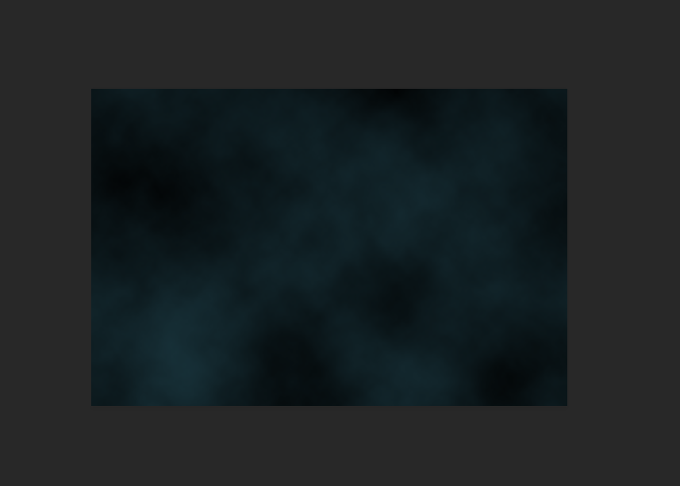
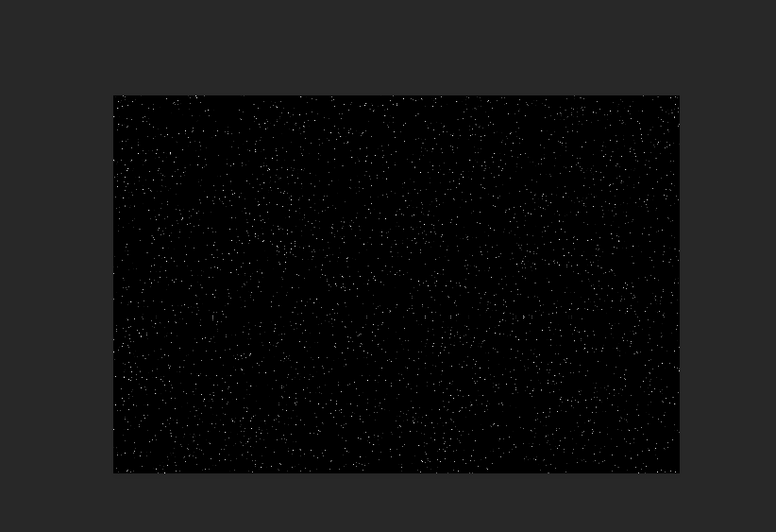

Step-1) Created a new file 600 by 400 pixels and black background color, foreground color as #18323a
Step-2) Choose Filter > Render > Clouds
Step-3) Created a new layer and fill it with black as Stars.
Step-4) Choose Filter > Noise > Add Noise and Set Amount 30%, Gaussian, Monochromatic, adjust choose Image > Adjust > Levels and set Input levels at 160, 1.55, 255 and changed the blending mode of Stars layer to Screen
Step-5) Wrote text SPACE using white color and font Bank-Gothic, size 100 pt.
Step-6) Use Color Overlay of black color, Drop Shadow, color #008ac5, Screen, size 5 pixels, 64% opacity,
Inner Shadow, color #54a4ff, Screen, Outer Glow, color #008ac5, Screen, spread 4%, size 100pixels,
Inner Glow, size 5 pixels.

Slide 3

Final Image

